Slide 1
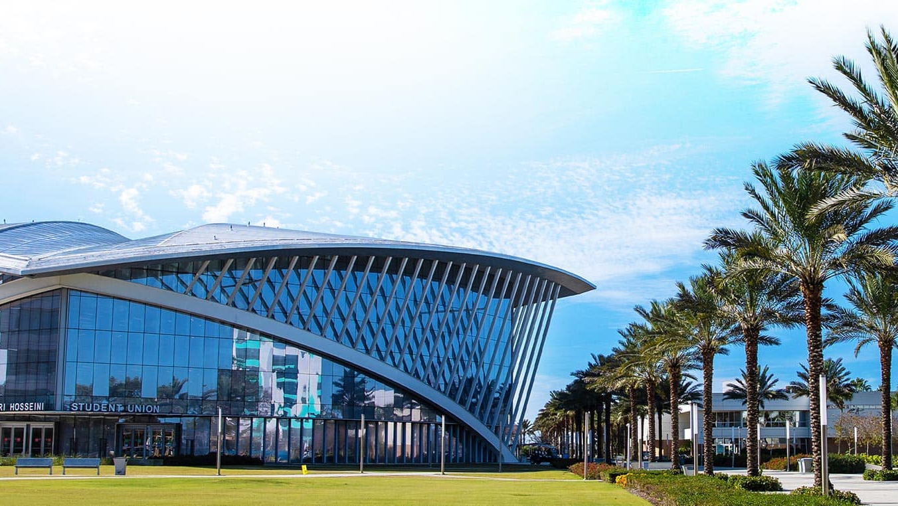


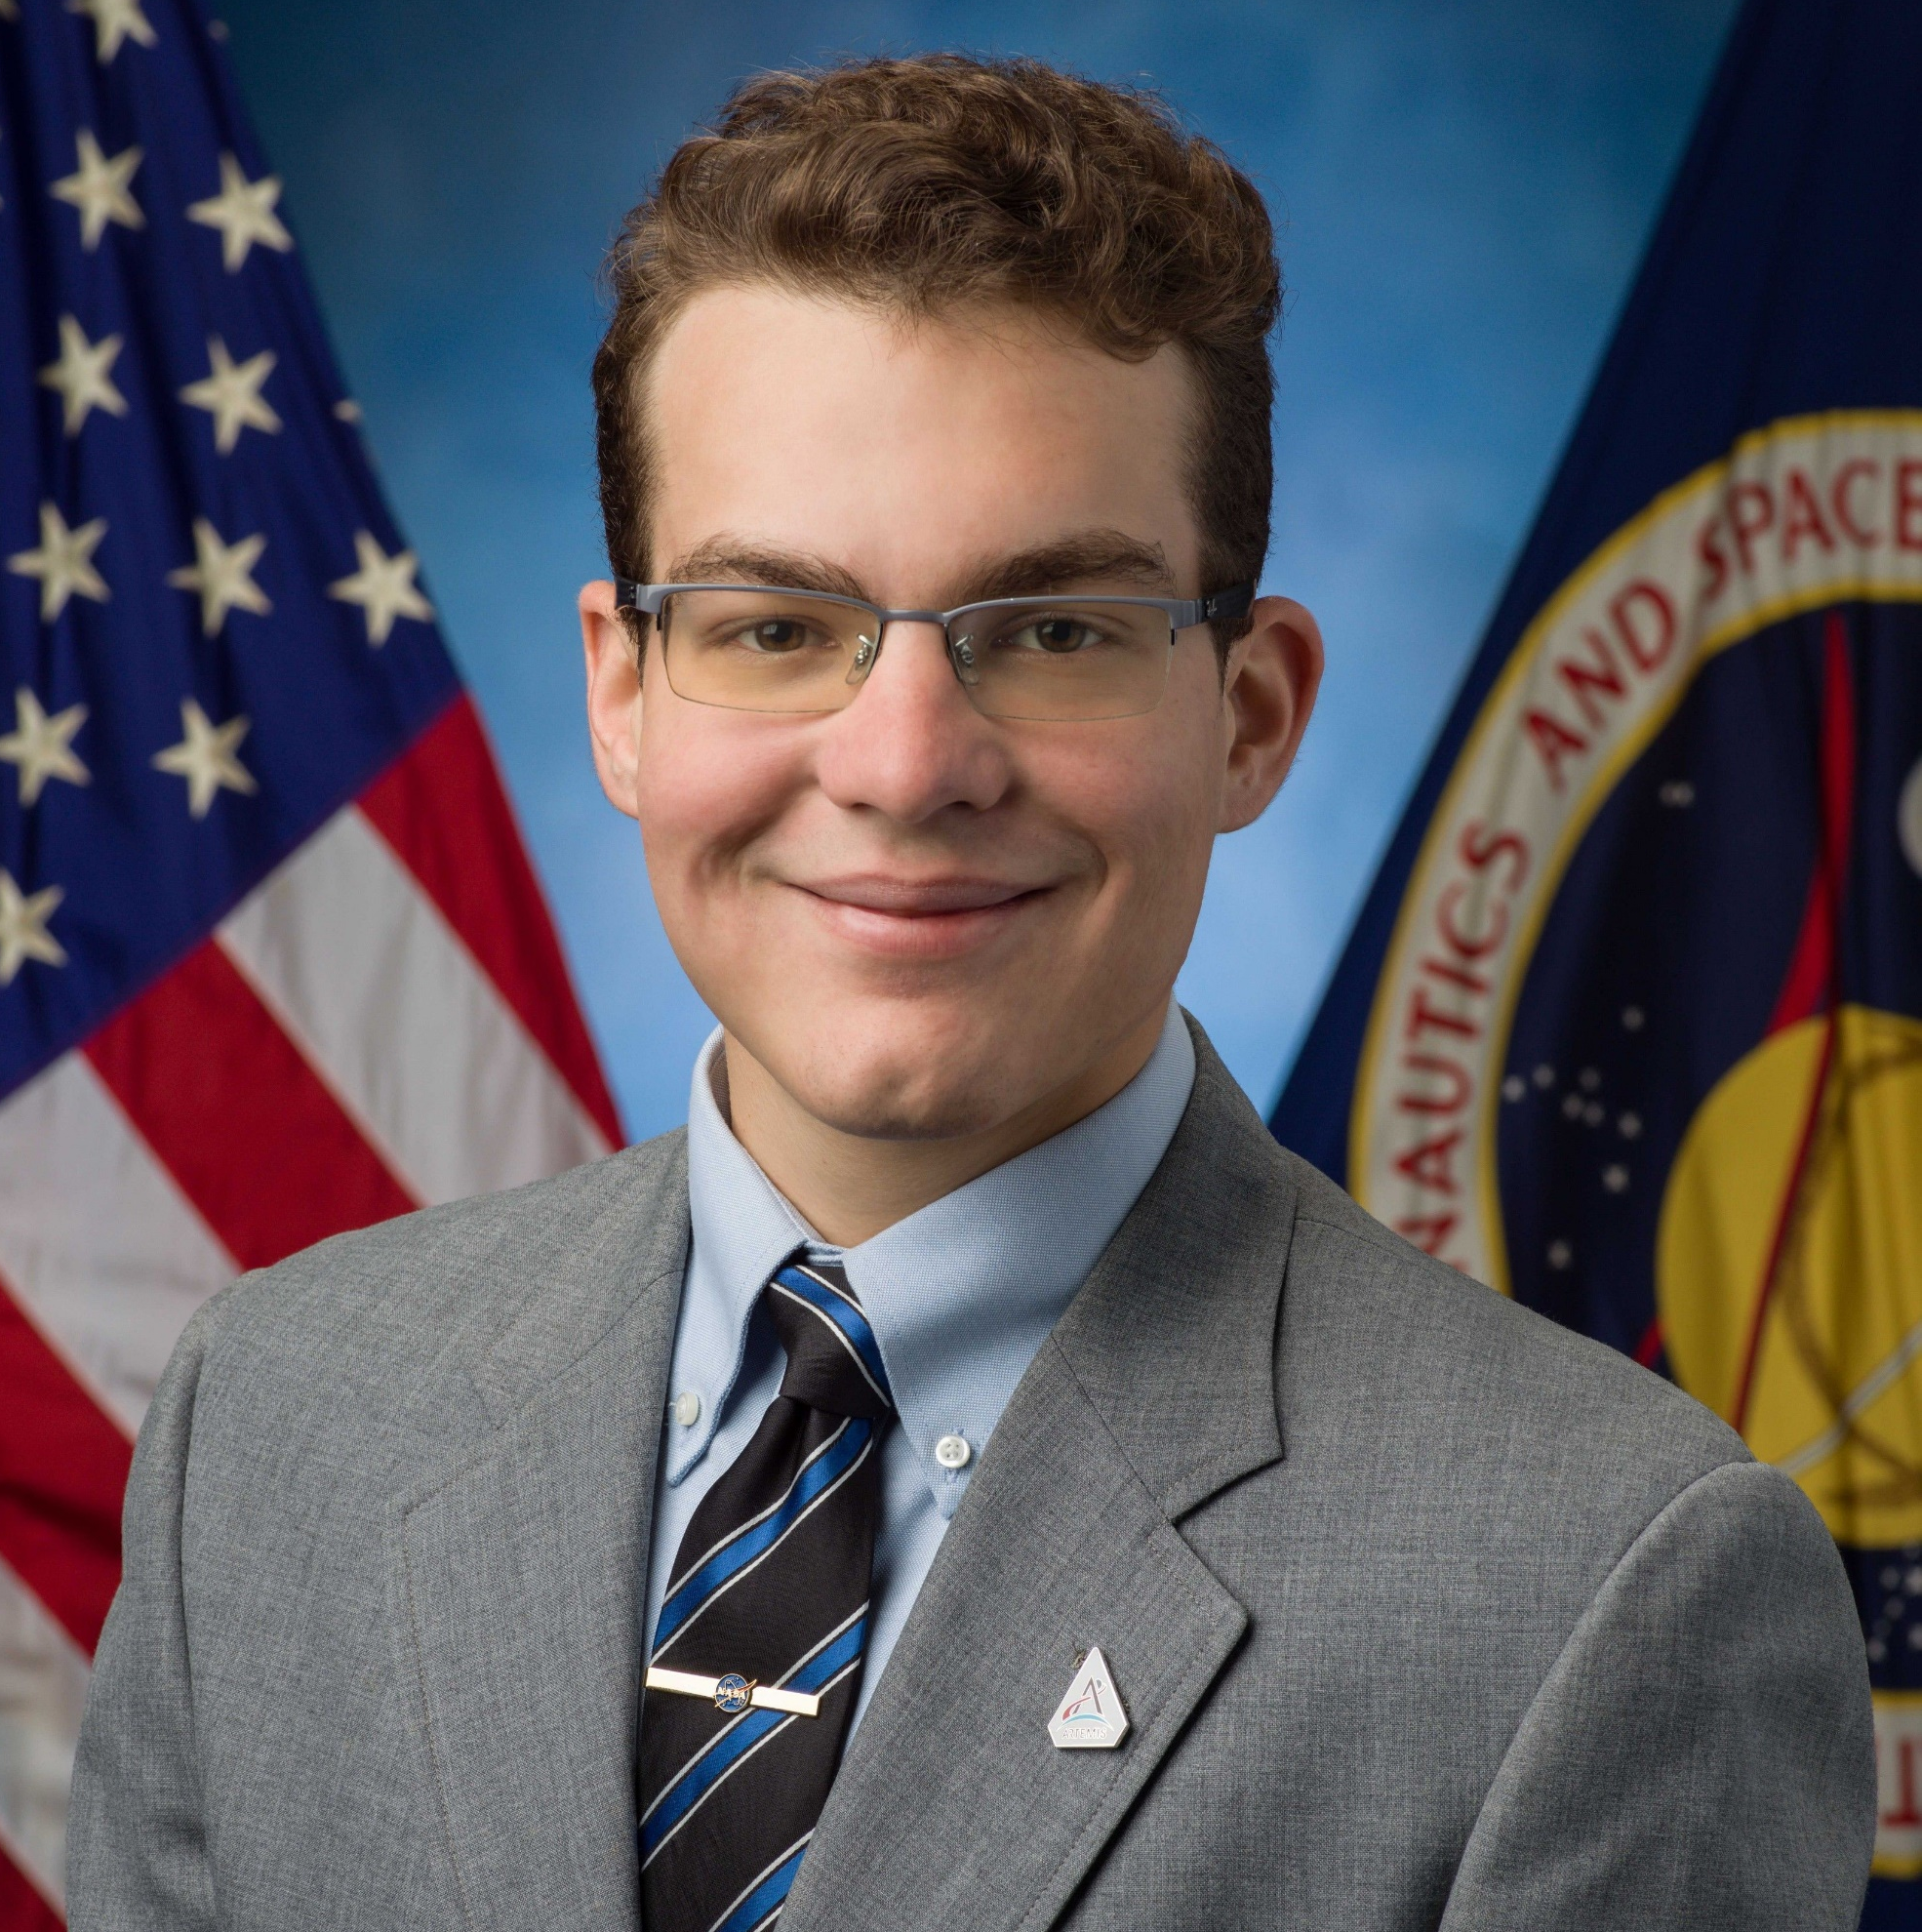



Model-Based
Avionics
System
Capstone
Shawn Merrick Miller, Electrical Engineering
Walter Hernandez, Computer Science
William Pate, Software Engineering
Luke Newcomb, Software Engineering

Slide 2
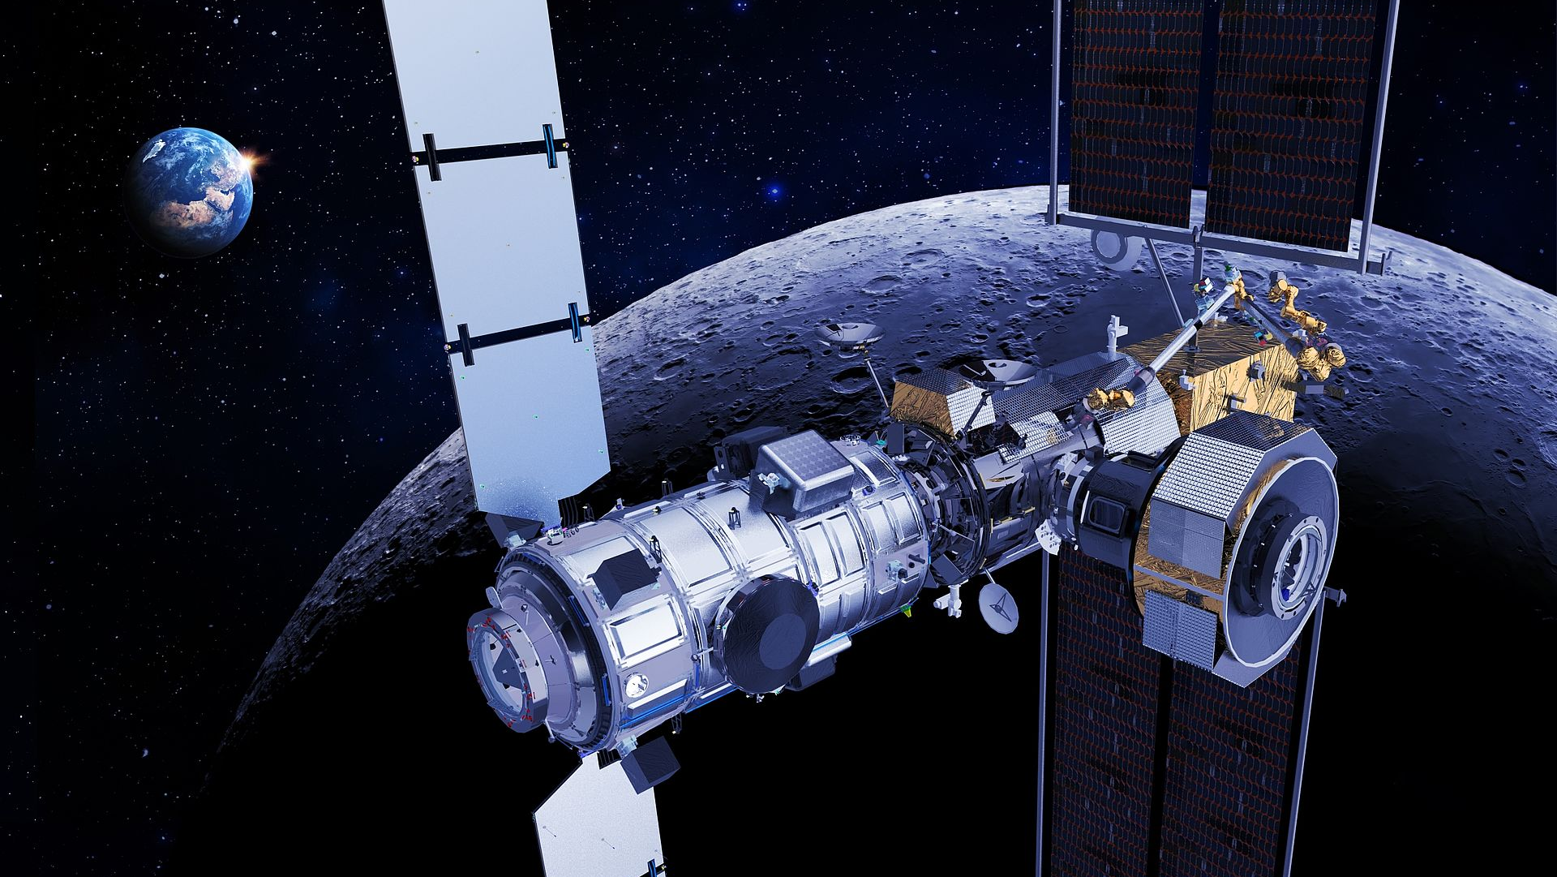
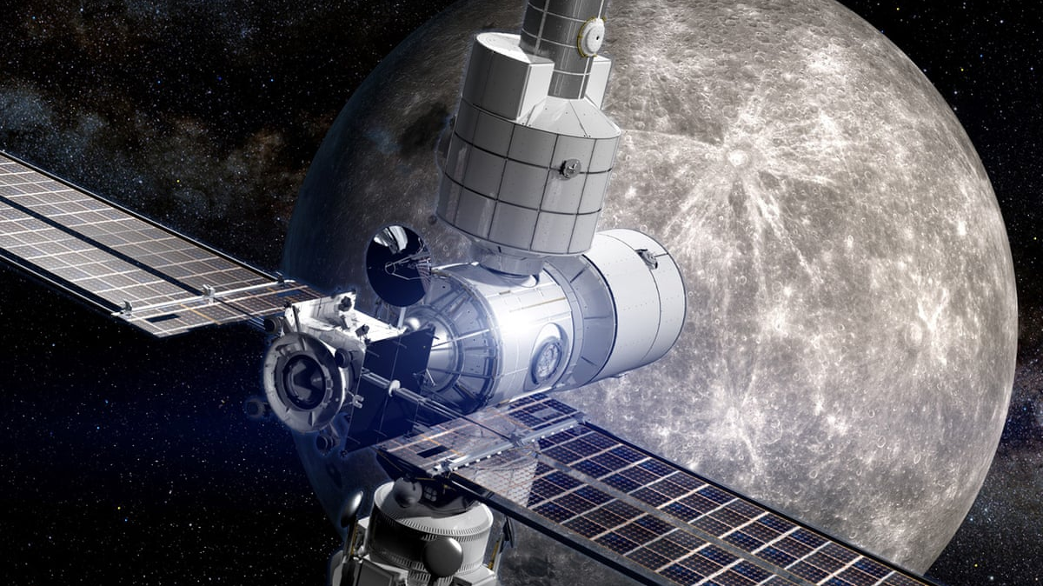
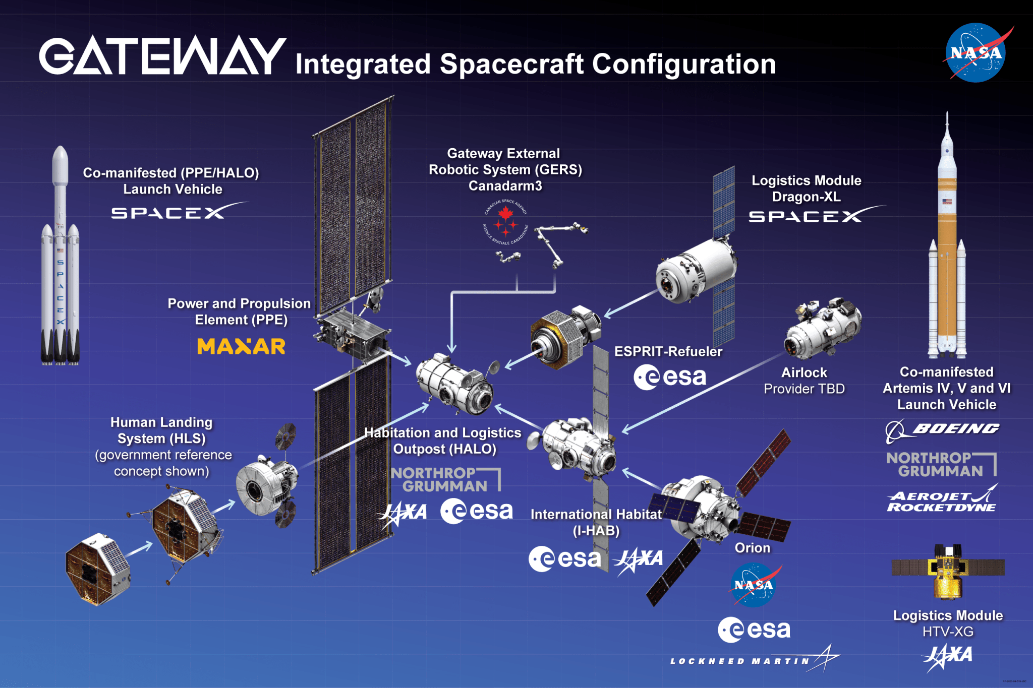
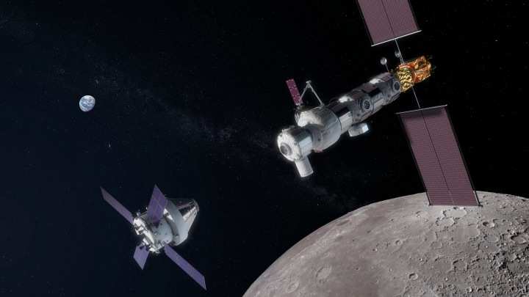
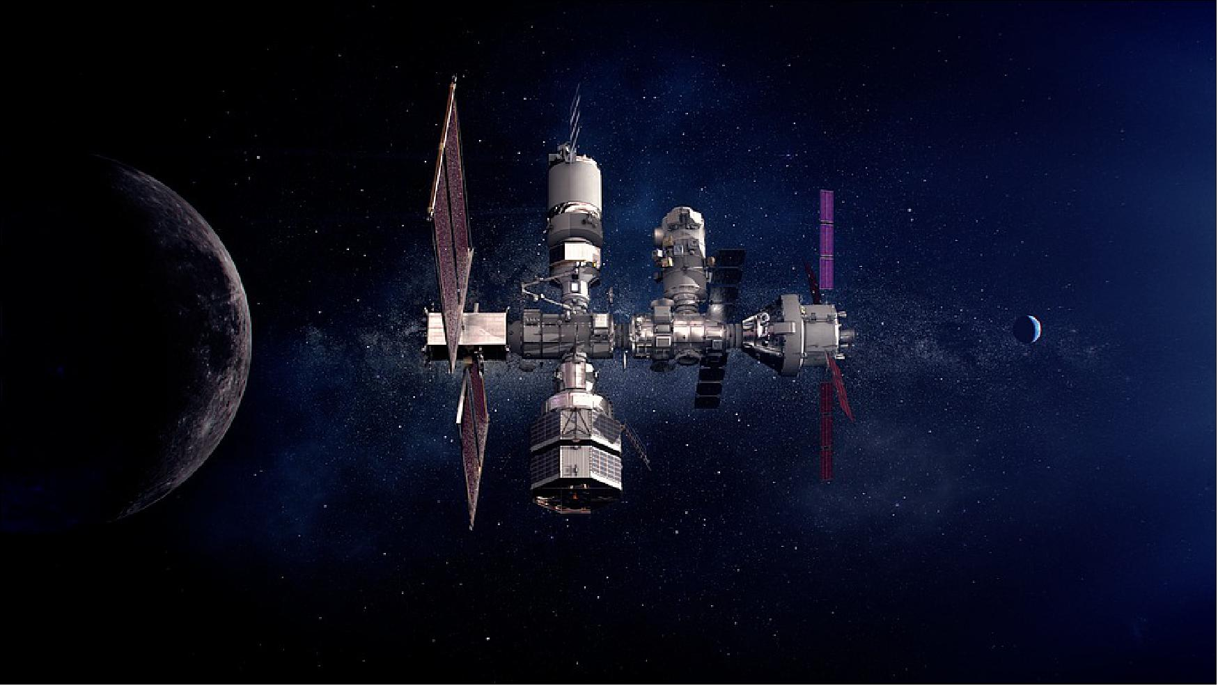
“Extremely costly with traditional systems engineering practices”

Slide 3
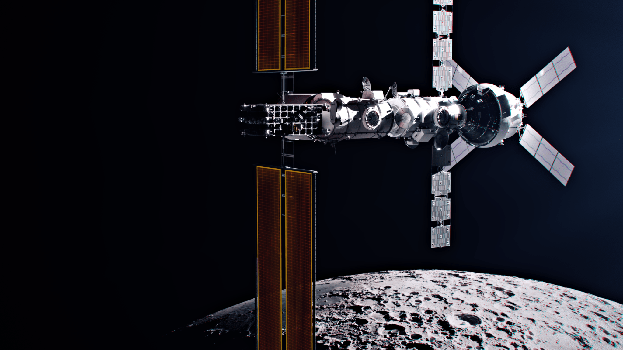
Model-Based Systems Engineering (MBSE)
Capture dynamic system configurations
Allocate system specifications to discrete solution implementations
Query system design for performance information
Failure Mode Effects Analysis
(FMEA)
Recognize and evaluate the potential failure(s) of an item or process
Determine the effects of a failure on the system
Identify actions that could reduce the likelihood of the failure occurring
“MASC will demonstrate the viability of MBSE for analysis tasks like FMEA”

Slide 4
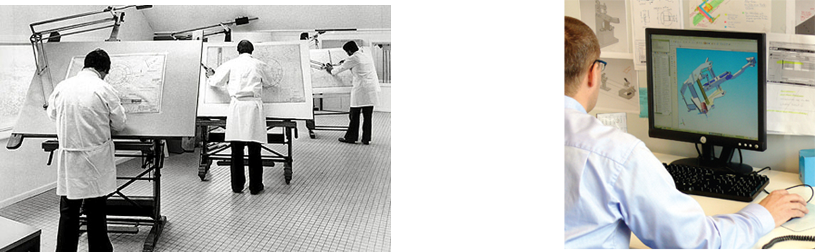
“Modelling has been extremely successful in other disciplines”
Mechanical Engineering is an example
Traditional Drafting
Computer Aided Drafting

Slide 5
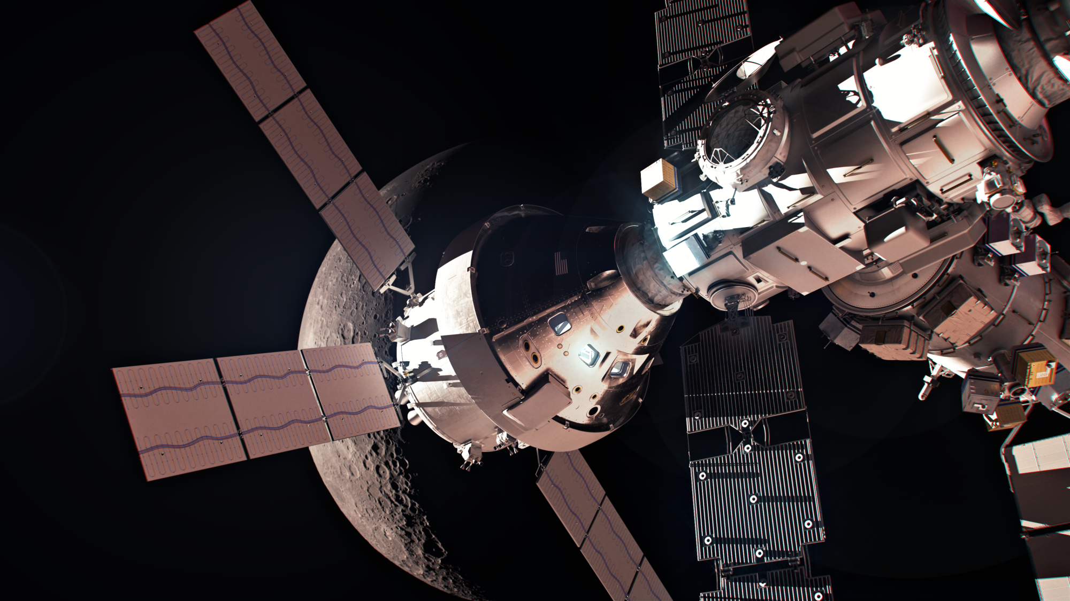
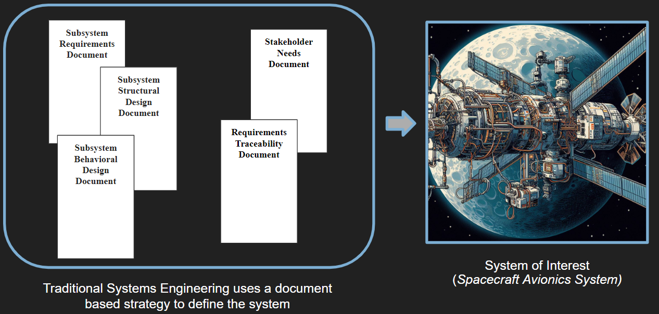
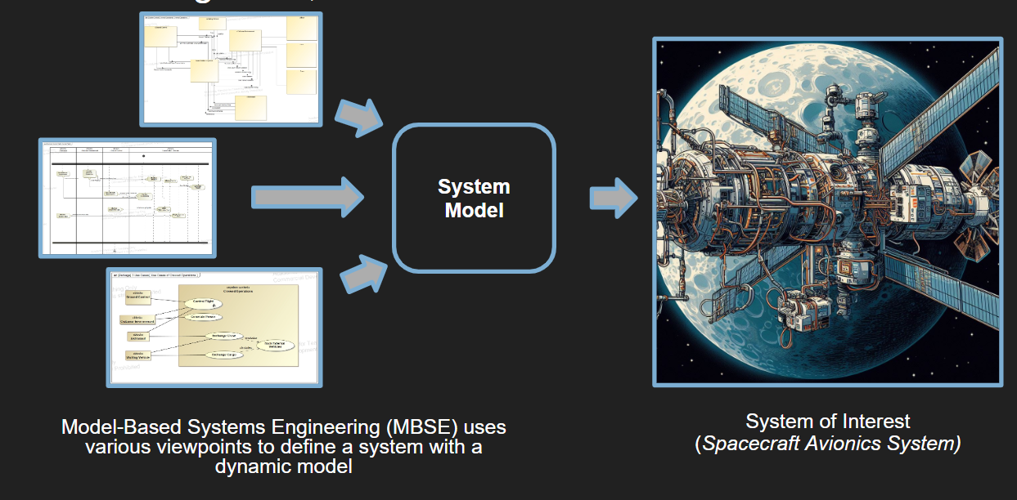
“Systems modelling represents a leap forward in the way systems are designed”

Slide 6
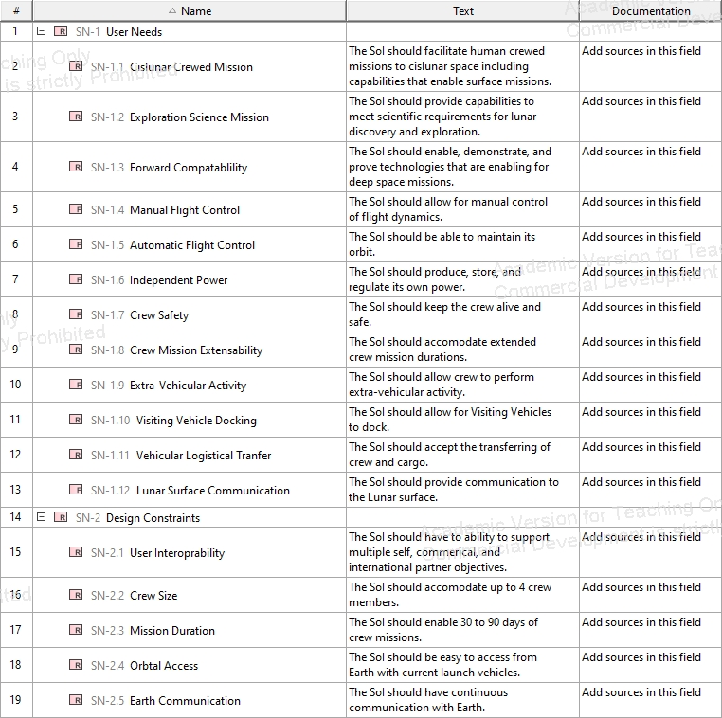
Capture Stakeholder Needs

Slide 7
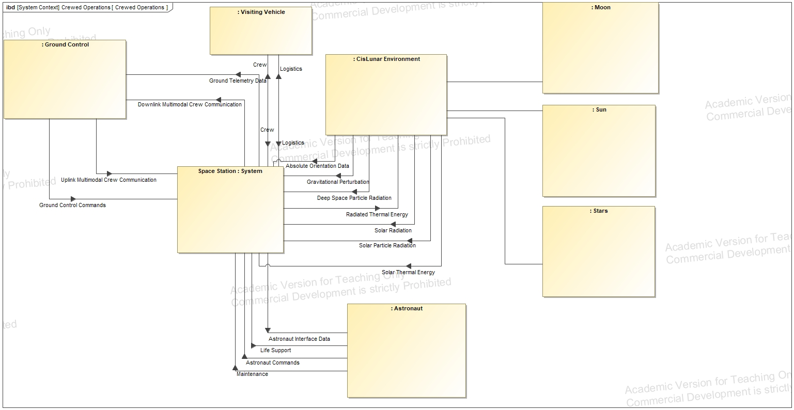
Defining System Structure

Slide 8
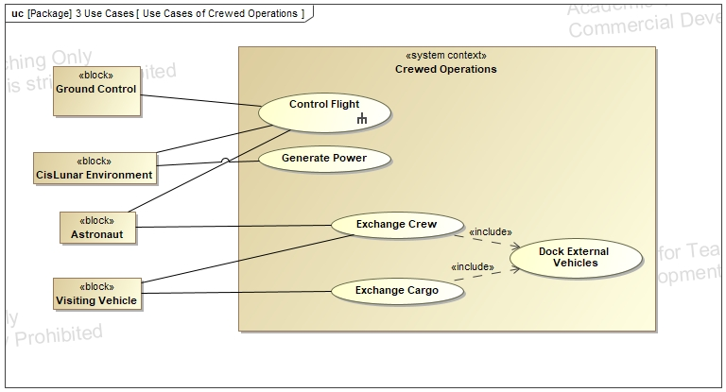
Defining System Behavior

Slide 9
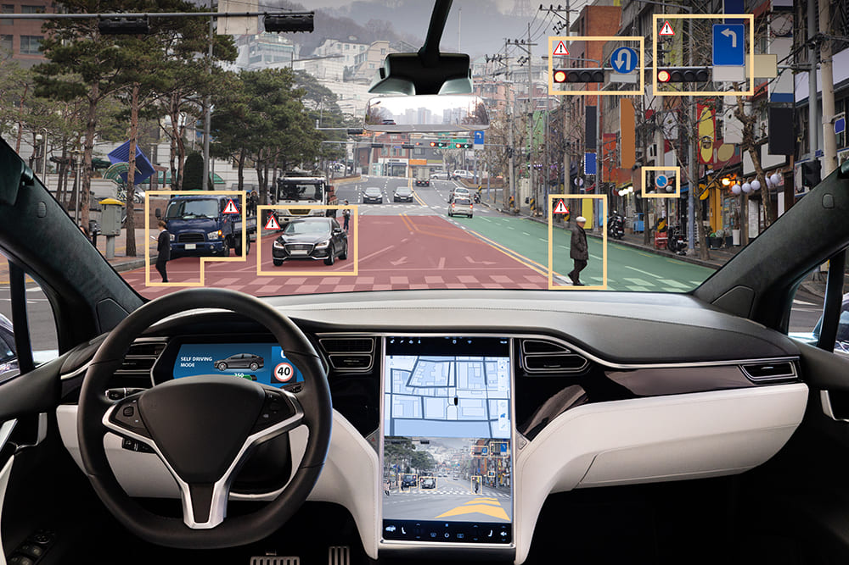

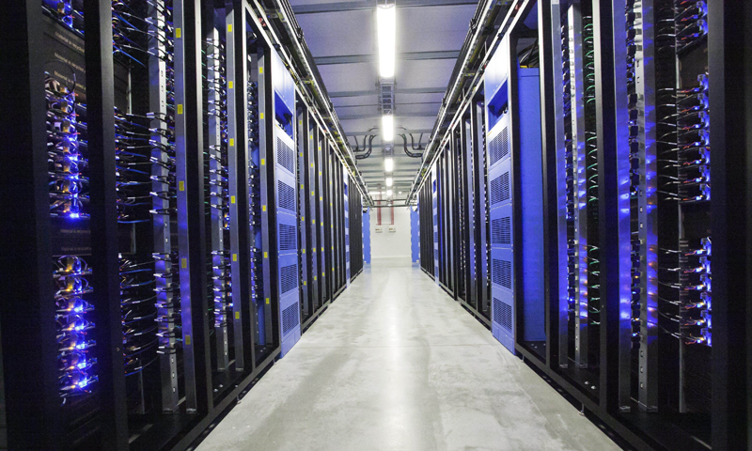
Why is this useful?
Reduce schedule burden
Better system understanding earlier
Improved safety and reliability metrics
Lower cost for system changes
Everything is a system
“System modelling is applicable in every domain”

Slide 10

Thank You!
Please reach out with any questions
Shawn Merrick Miller
merrics1@my.erau.edu

